Slide 1

Sun Hacks - 2022
Team TechBark
SHM-01
Nachiket Shilwant
Kartikey Sakare
Dhammadip Kamble
Pranav Umak

Slide 2
Problem Statement:
Uplifting your Happiness Index by infusing Digital Technology.
Theme:
Artificial Intelligence and Machine Learning.
Description:
Identify and gather Happiness Index using different sources like human behavior, lifestyle, etc.
Detect stress management. Proactively provide recommendations to increase Happiness Index
Expectations:
Uplifting Happiness

Slide 3
List
of
Contents
01
02
ABSTRACT
TECHNOLOGIES
& TOOLS
03
04
DESIGN MODULES
IMPLEMENTATION
05
06
BUSINESS MODEL
SOCIETAL IMPACT

Slide 4
01
Abstract
In this project, we analyse each person's individual happiness index using a few questionnaires on human behaviour and facial recognition.
To date, researchers proposed many factors that may affect happiness such as wealth, health and safety.
Even though these factors all seem relevant, there is no clear agreement between sociologists on how to interpret these, and the models to estimate the cost of these utilities include some assumptions.

Slide 5
01
Abstract
In our approach, we present a unique and comparatively impartial approach to this problem by utilising machine learning and deep learning techniques.
In order to determine a person's happiness index, we have selected some of the 290 behavioural questions from 14 factors i.e. Social values, attitudes & stereotypes, happiness and well-being, etc using data analysis.
While completing the survey, a camera is also recording real-time feelings that is eventually be contributed to the happiness index.

Slide 6
02
Technologies &
Tools
Python
OpenCV
Keras
TensorFlow
Pandas
Tkinter
NumPy
Matplotlib
Seaborn
Scikit-Learn
Web Development

Slide 7
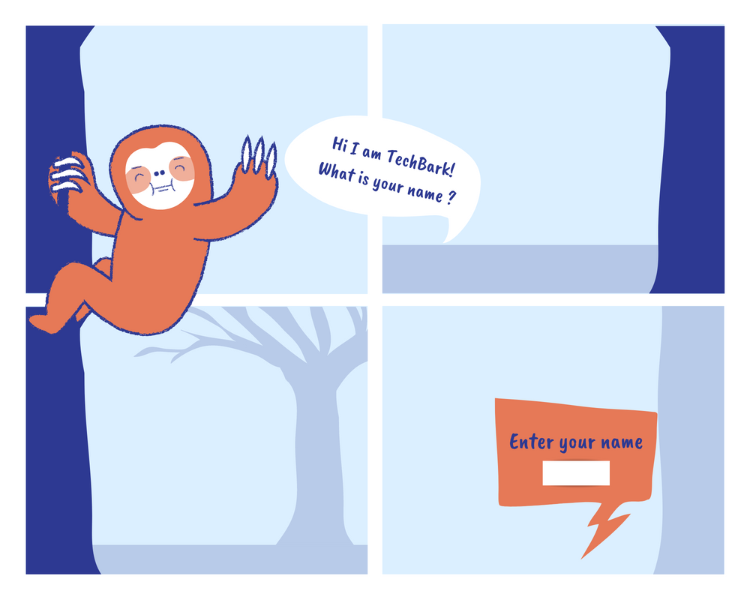
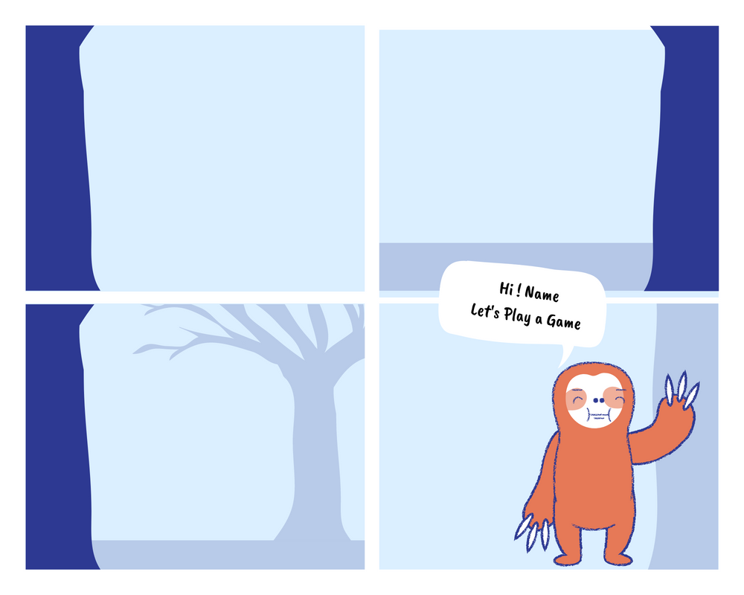
03
Design Modules
Gamification

Slide 8
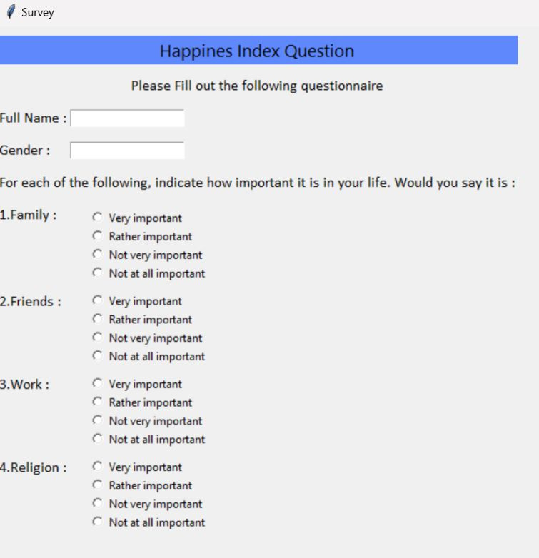
03
Design Modules
Tkinter - GUI
Tkinter is the inbuilt python module that is used to create GUI applications.
(GUI) is a form of user interface which allows users to interact with computers through visual indicators using items such as icons, menus, windows, etc. It has advantages over the Command Line Interface(CLI)
Our older version of Tkinter's graphical user interface.

Slide 9
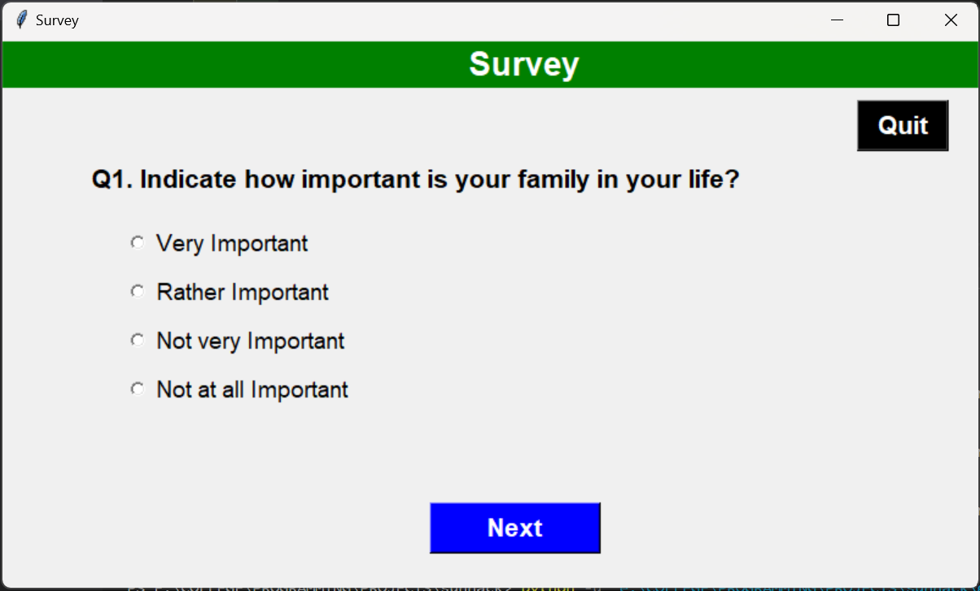
03
Design Modules
Tkinter - GUI
It is widely used and easy to work with.
That's why, we have used it for the questionnaire.
Our newer version of Tkinter's graphical user interface.

Slide 10
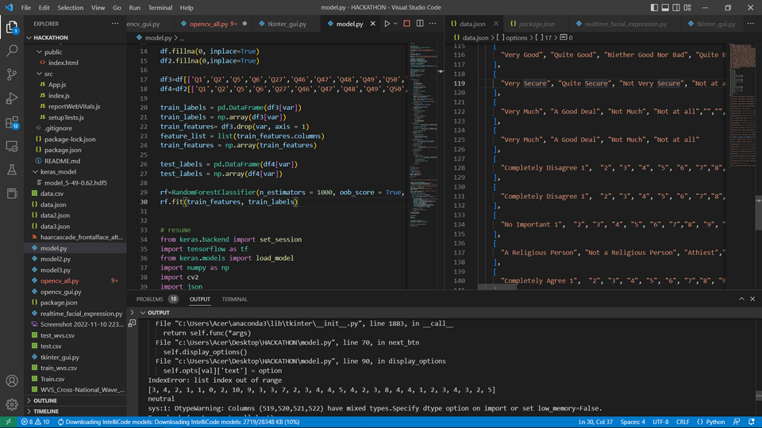
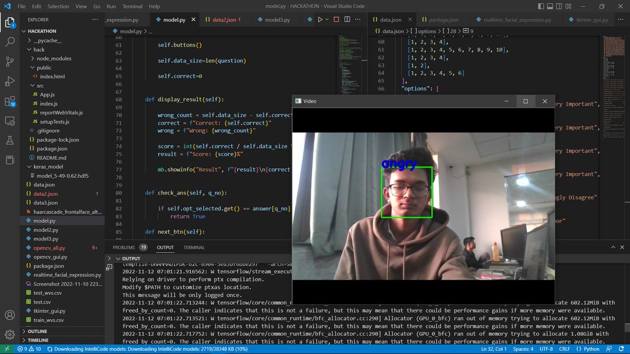
04
Implementation
The implimentation of project will be shown through screen presentation

Slide 11
05
Business Model
A lot of toxic world-life cultures exist in some workplaces, which negatively impacts many employees and ultimately results in the demise of the business.
Companies may therefore determine their employees' Happiness Indexes and assist them in preventing an issue from arising.
As one of our USPs is Gamification Survey, we can offer this in market after implementing it fully.

Slide 12
06
Social Impact
The Happiness Index is a tool to assess, understand, and enhance an individual's happiness, community well-being, social justice, economic equality, and environmental sustainability.
The Happiness Index can be used to measure: the impact of social injustice, climate injustice, income inequality, disengagement from the democratic process, loneliness, isolation, ill health, and other aspects of human suffering within a population or specific demographics of a people.

Slide 13
Refrences
Dataset: World's value Survey
Survey reference: UNDP(United Nations Development Programme), CIDA (Consortium for Industry Development and Awareness ), IDRC(International Development Research Centre)

Slide 14
Our Future Ideas related
to this Project
1 - To release fully gamified story based version of survey.
2 - To add extra features which will contribute more to the accuracy using IOT, Audio Effects, etc

Slide 15
THANK YOU

